Slide 1

Let’s start with Allah Yaar
Bs in Computer Science

Slide 2
Digital Economics
Digital Economics
Digital economics studies the production, distribution, and consumption of goods and services in a digital ecosystem. It focuses on how technology transforms traditional economic activities into digital processes.

Slide 3
Digital Economics
Key Features:
Data as a Resource: Data drives decisions in the digital economy.
Example: Companies like Google and Facebook use user data for targeted advertising.
Global Reach: The internet enables businesses to operate across borders.
Example: E-commerce platforms like Amazon serve a global customer base.

Slide 4
Digital Economics
Automation and Efficiency: Digital tools enhance efficiency in industries.
Example: Automated payment systems like PayPal or Google Pay.
Impact:
Boosts innovation through competition.
Provides opportunities for small businesses to compete on a global scale.

Slide 5
Digital Goods and Services
Digital Goods and Services
Digital goods and services refer to products and services that are created, delivered, or consumed in a digital format.
Digital Goods:
Products that exist only in digital form and are distributed electronically.
Examples:
E-books (e.g., Kindle books).
Software downloads (e.g., Microsoft Office).
Music and video streaming (e.g., Spotify, Netflix).

Slide 6
Digital Goods and Services
Digital Services:
Services provided through digital platforms.
Examples:
Cloud computing (e.g., Google Drive).
Online education platforms (e.g., Coursera, Khan Academy).
Telemedicine services (e.g., doctor consultations via apps).

Slide 7
Digital Goods and Services
Advantages:
Instant delivery and access.
Scalability with minimal additional costs.
Environmentally friendly due to reduced physical production.

Slide 8
Production of Digital Services
Production of Digital Services
Digital service production involves creating and delivering services using ICT tools and platforms.
Modes of Production:
In-House Production: Services created entirely by a company's resources.
Commons-Based Peer Production: Collaborative efforts of a community.

Slide 9
Production of Digital Services
Commons-Based Peer Production: Collaborative efforts of a community.
Crowdsourcing: Outsourcing tasks to a distributed group of people.
Open-Source Software: Software developed collaboratively and freely available.
Steps in Production:
Ideation: Generating ideas for new services.
Example: Designing a language-learning app like Duolingo.

Slide 10
Production of Digital Services
Development: Creating the service using software tools.
Example: Coding and testing the app.
Delivery: Providing the service to users.
Example: Uploading the app to Google Play or App Store.

Slide 11
In-House Production
In-House Production
In-house production refers to creating digital goods or services within an organization using its resources.
Advantages:
Full control over quality and intellectual property.
Customized solutions tailored to business needs.

Slide 12
In-House Production
Disadvantages:
Requires significant investment in technology and skilled personnel.
Example: A company developing its own CRM software instead of using a third-party tool.

Slide 13
Commons-Based Peer Production
Commons-Based Peer Production
This is a model where individuals collaboratively work on projects for the benefit of the community without direct financial compensation.
Key Features:
Voluntary participation.
Open access to resources and contributions.
Transparency in decision-making.

Slide 14
Commons-Based Peer Production
Examples:
Wikipedia: A collaboratively edited online encyclopedia.
OpenStreetMap: A community-driven project to create a free and editable map.
Advantages:
Promotes innovation through diverse contributions.
Cost-effective as it leverages community resources.

Slide 15
Commons-Based Peer Production
Challenges:
Coordination issues among contributors.
Ensuring the quality and reliability of outputs.

Slide 16
Crowdsourcing
Crowdsourcing
Crowdsourcing involves obtaining input, ideas, or services from a large group of people, typically via the internet.
Types of Crowdsourcing:
Crowd Voting: Gathering opinions or feedback.
Example: Choosing a logo design through public votes.

Slide 17
Crowdsourcing
Crowd Creation: Generating content or solutions.
Example: YouTube, where users create and share videos.
Crowd Funding: Raising money from the public.
Example: Kickstarter, a platform for funding creative projects.
Advantages:
Access to a wide pool of ideas and skills.
Cost-effective for businesses.

Slide 18
Crowdsourcing
Challenges:
Managing and validating contributions.
Maintaining contributor motivation.

Slide 19
Open-Source Software
Open-Source Software
Open-source software (OSS) refers to software with source code that is freely available for use, modification, and distribution.
Characteristics:
Open access to source code.
Collaboration among developers.
Free to use and distribute.

Slide 20
Open-Source Software
Examples:
Linux Operating System: Widely used in servers and embedded systems.
Apache HTTP Server: A popular web server software.
Mozilla Firefox: An open-source web browser.
Advantages:
Transparency: Users can verify and improve the code.
Cost-effectiveness: Free to use and modify.
Community Support: Active developer communities provide support and updates.

Slide 21
Open-Source Software
Disadvantages:
Limited official support compared to proprietary software.
Steeper learning curve for less user-friendly tools.

Slide 22
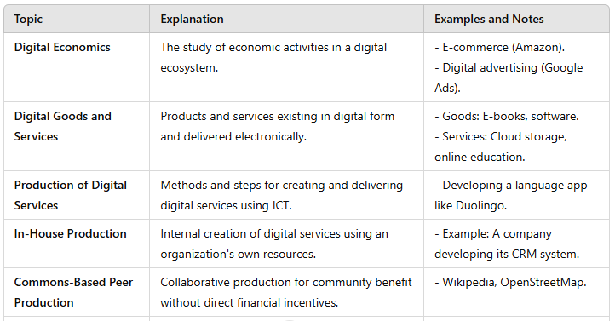
Summary Table

Slide 23
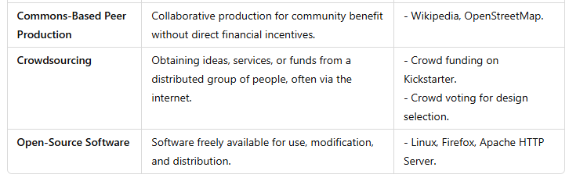
Summary Table

